Slide 1
Human-AI Interaction
Tommaso Turchi
Adapted from:
https://elite.polito.it/2024-haii-materials/

Slide 2


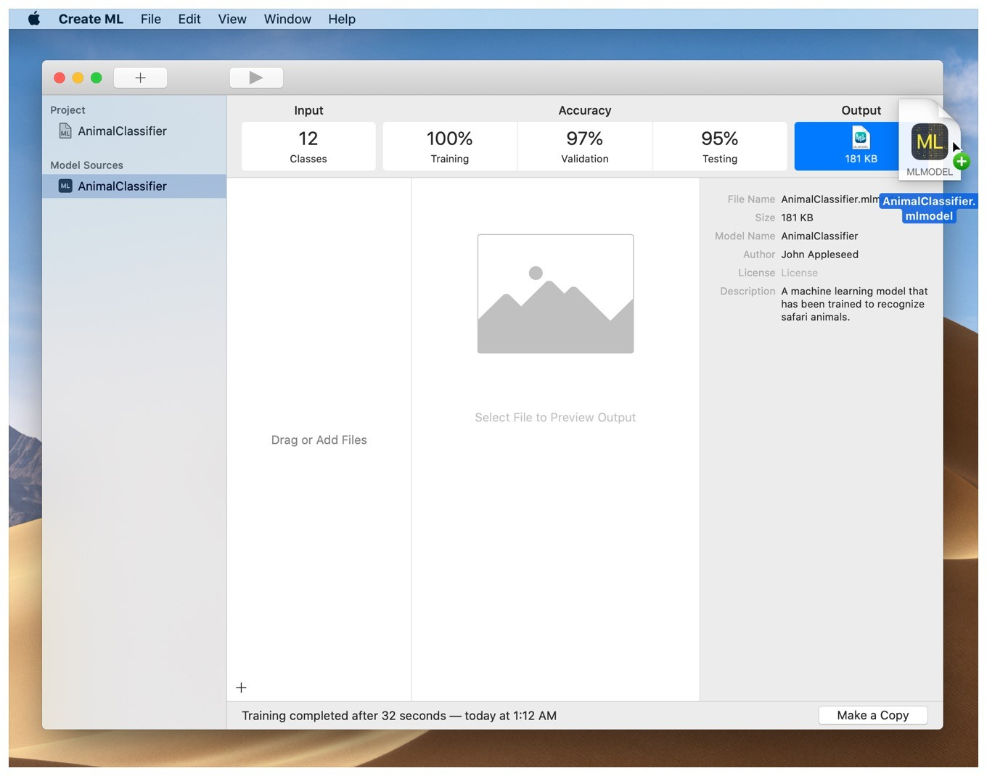
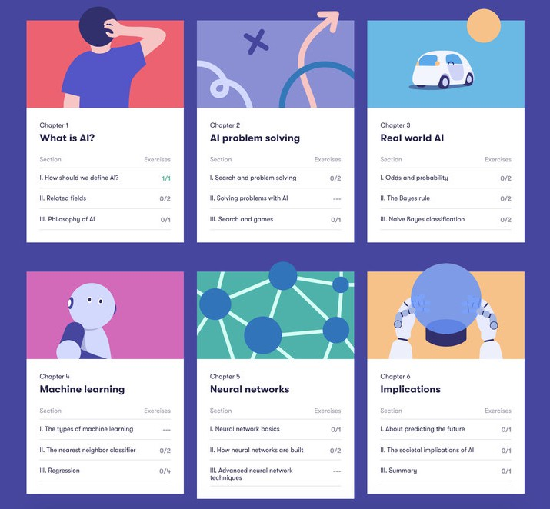
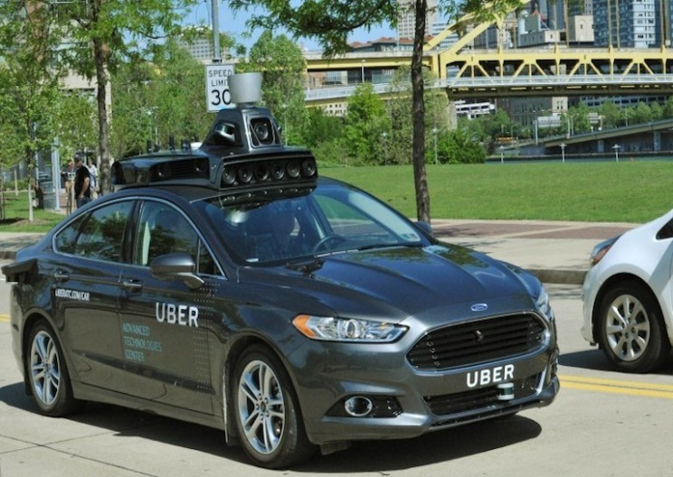
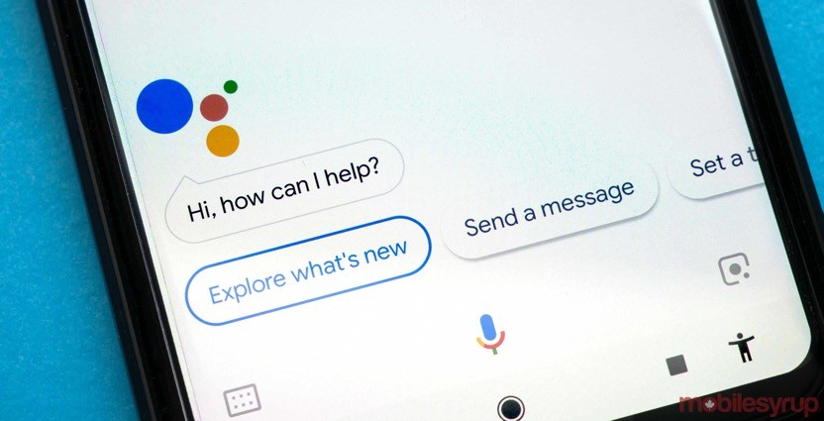
AI is everywhere!

Slide 3
AI is everywhere!
When it "works", it's great!

Slide 4

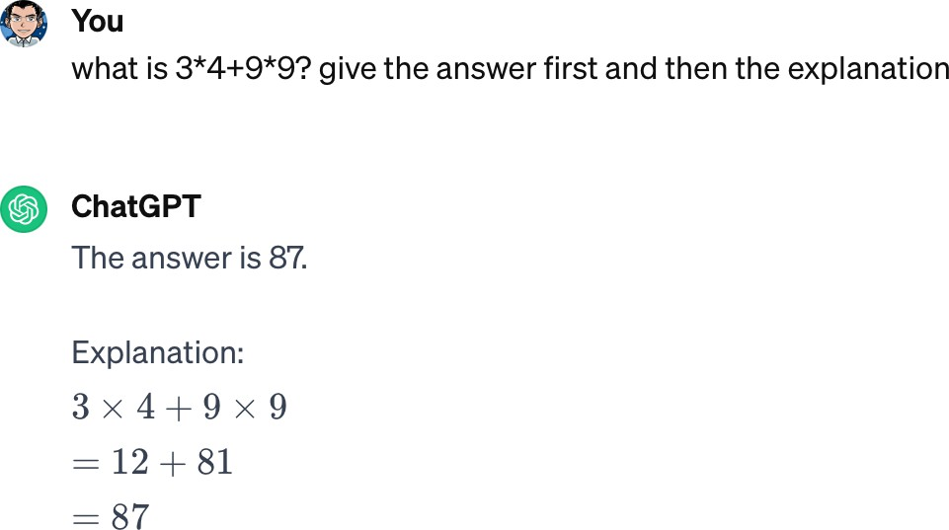
AI is everywhere!
When it "fails", it does it spectacularly…
e.g., Tesla Smart Summon, https://www.youtube.com/watch?v=VbVoTK-lM00

Slide 5
AI is everywhere!
… and/or it is very problematic, for instance:
"IBM boasted that its AI could 'outthink cancer.' Others say computer systems that read X-rays will make radiologists obsolete…"
"Systems developed in one hospital often flop when deployed in a different facility.
Software used in the care of millions of Americans has been shown to
discriminate against minorities.
And AI systems sometimes learn to make predictions based on factors that have less to do with disease than the brand of MRI machine used, the time a blood test is taken or whether a patient was visited by a chaplain."
[source: https://www.scientificamerican.com/article/artificial-intelligence-is-rushing-into-patient-care-and-could-raise-risks/]
Why?

Slide 6



A Possible Reason: The Typical Approach
Instances
Data
AI Magic
Predictions/ Results

Slide 7
Motivation
Most AI/ML courses consider “user interfaces” or humans as an afterthought, near the end
several times they do not even think about "humans" ☹
they focus on algorithms/models, basically
Why do not consider people from the beginning, and along the design, algorithmic choices, … in an iterative way?!

Slide 8
Ultimately, AI Systems Are…
Designed by humans
To solve a problem framed by humans
With humans taking specific choices (e.g., which algorithm to use)
Evaluated and tested by humans
With an outcome for humans (often)
Presented to humans with a user interface (sometimes)

Slide 9
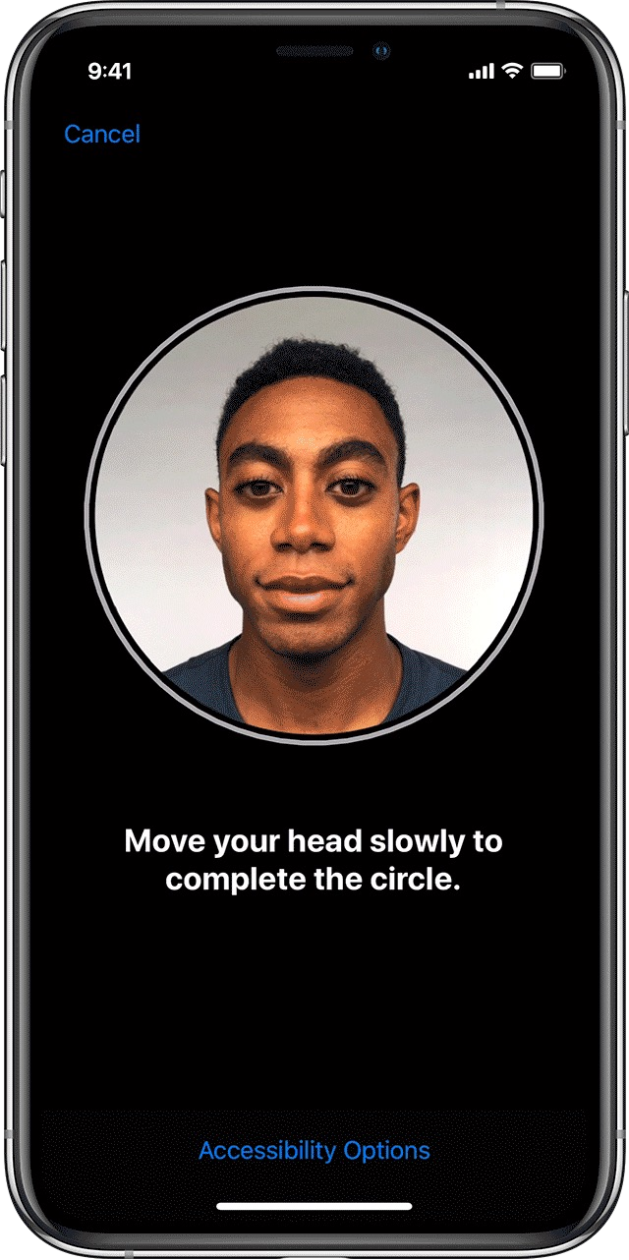
Algorithms As The (Main) Answer?
Algorithms are not always the “answer”
for instance: if you go to Netflix for the first time, what should it recommend you watch?
this is the cold start problem, and it is not really and fully solved
algorithmically speaking, at least
⇒ A suitable user interface is critical to overcome some limitations!
Keeping people involved and considering them since the beginning is fundamental!

Slide 10
Challenges
How to ensure that people use AI-powered interfaces and systems with joy and trust rather than frustration and disappointment?
How can we design and evaluate human-centered AI systems?
How can we avoid (or minimize) problems, failures, ethical issues, … in AI systems?

Slide 11
People & Computers
“The two hardest problems in computer science are: (i) people, (ii), convincing computer scientists that the hardest problem in computer science is people, and, (iii) off by one errors.”
Prof. Jeffrey P. Bigham, 2018 http://www.cs.cmu.edu/~jbigham/

Slide 12
What is Different in Interactive AI Systems?
AI-based systems are typically performed under
uncertainty
often producing false positives and false negatives
they can be incorrect
They may demonstrate unpredictable behaviors that can be disruptive, confusing, offensive, and even dangerous for users

Slide 13
Human-Centered AI
Human-centered AI focuses on amplifying, augmenting, and enhancing human performance in ways that make AI systems reliable, safe, and trustworthy
Shift from measuring only algorithm performance to evaluating human performance and satisfaction, with human-centered and participatory approaches (for evaluation, too)
Ben Shneiderman, Bridging the Gap Between Ethics and Practice: Guidelines for Reliable, Safe, and Trustworthy Human-centered AI Systems. ACM Transactions on Interactive Intelligent Systems, Vol. 10, No. 4, Article 26, 2020, https://doi.org/10.1145/3419764
Human-AI Interaction

Slide 14
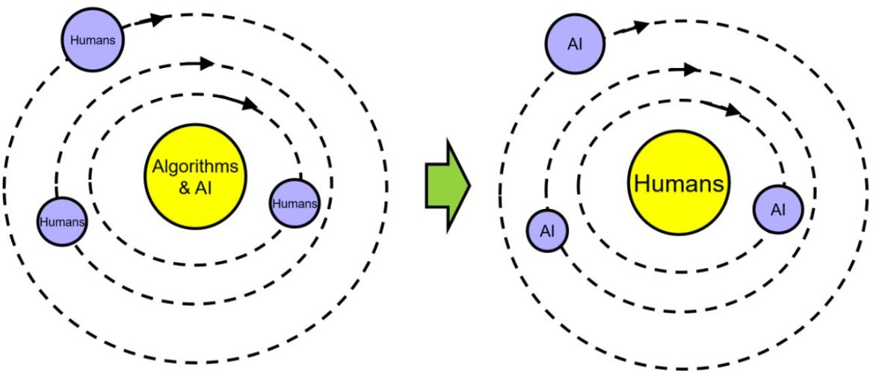
A Paradigmatic Change

Slide 15
Can AI and People Really Work Together?
Should we design and develop technology that
automatizes people's actions, replaces humans (Artificial Intelligence)
or augments them (Intelligent Augmentation)?
Is there a clear winner?
Which kind of human-AI collaboration can we envision?
full human control… no human involvement?
full AI autonomy… no AI?
in which cases?

Slide 16

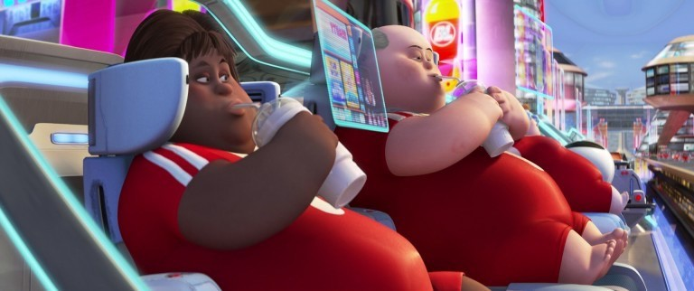
Artificial Intelligence vs. Intelligent Augmentation?

Slide 17
Put-That-There: Assumptions
About speech recognition
why do you need to point?
why do you need to talk?
what might go wrong?
About people
How would this augment them?
How might it fail?

Slide 18

Measuring Intelligence…
How do we measure “intelligence” in AI?
We can more accurately measure the joint performance of a task for a human together with AI
How human and machine together can achieve something that a human or the machine alone cannot (or would do worse)
Collaboration is the key

Slide 19
Humans or AI: Who Should Have The Conn?
It is essential that people feel in control of their lives and surroundings
When we “put intelligence” in things, people should:
be comfortable with the actions made by the intelligent system
understand why some actions are happening
trust the intelligent system
Automation is typically met with resistance
however, it can reduce the workload and allow to complete dangerous tasks
We should avoid (and consider) over-exaggerated expectations
claimed: “we have reach human-parity in speech recognition!”
pre-assumed: "I can speak with it, it understands my words, THUS it has full language understanding”

Slide 20
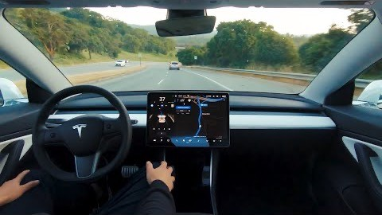
Full Self-Driving Cars
Who should be in control? When? What can go wrong? Why?
source: https://www.youtube.com/watch?v=tlThdr3O5Qo

Slide 21
Why Not Automating WHILE Augmenting?
Remember: collaboration, human-centered AI, …
“Human-centered AI focuses on amplifying, augmenting, and enhancing human performance in ways that make AI systems reliable, safe, and trustworthy”
Examples from the real world?

Slide 22
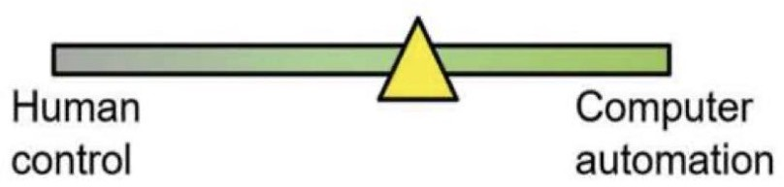
Human-Centered AI Framework
Until now, we have seen human control in contraposition to automation
This is also very typical
e.g., think about the levels of driving automation
Ben Shneiderman, Human-Centered Artificial Intelligence: Reliable, Safe & Trustworthy. 2020. International Journal of Human-Computer Interaction. https://doi.org/10.1080/10447318.2020.1741118

Slide 23
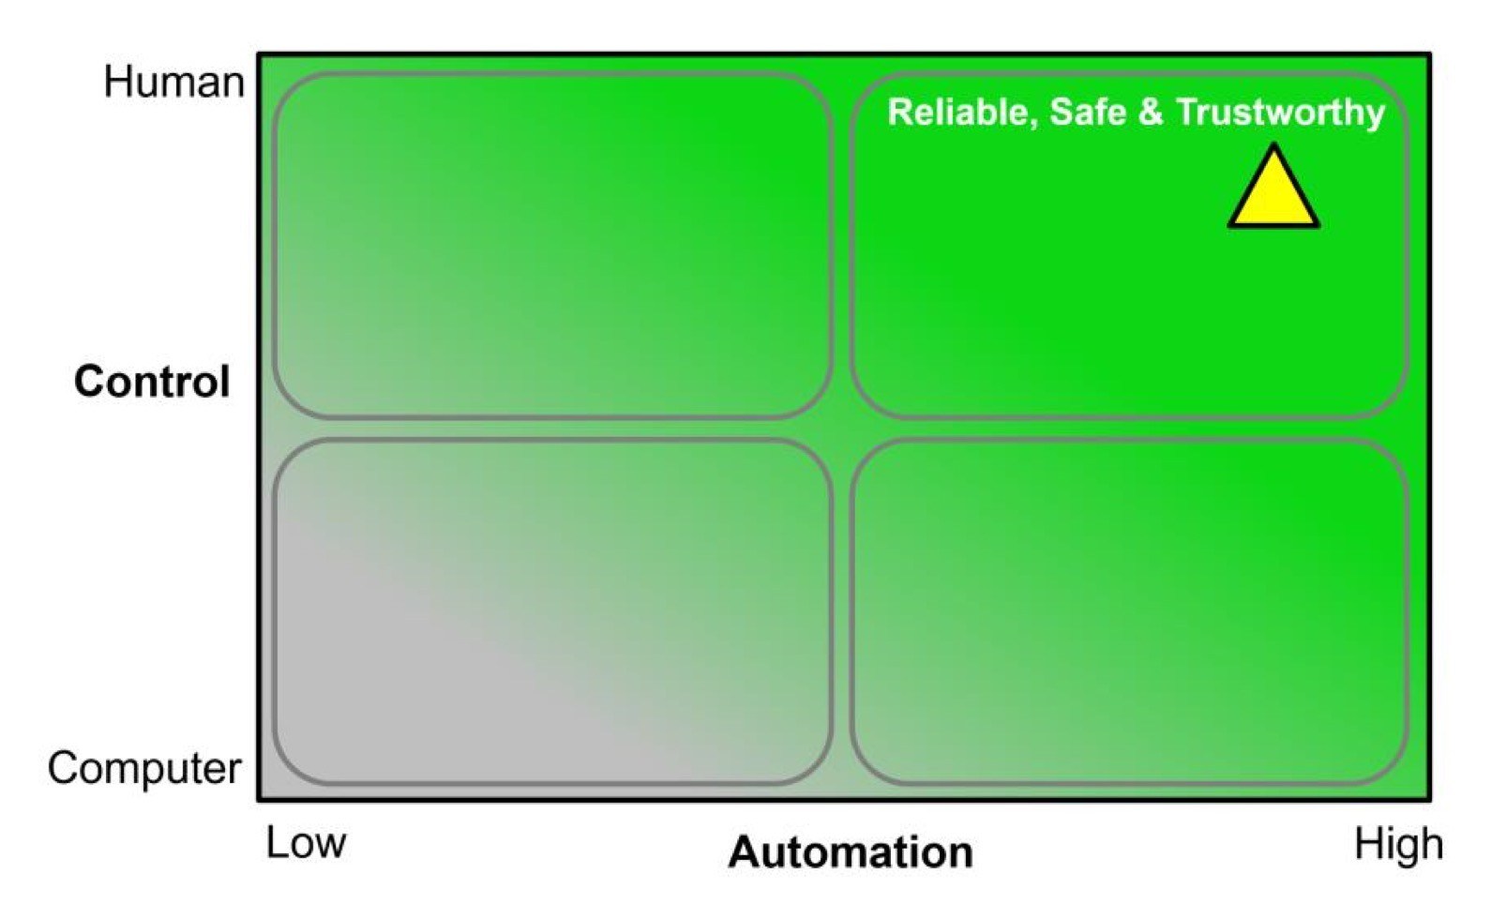
Human-Centered AI Framework
What if do we move to a 2D framework?
Ben Shneiderman, Human-Centered Artificial Intelligence: Reliable, Safe & Trustworthy. 2020. International Journal of Human-Computer Interaction. https://doi.org/10.1080/10447318.2020.1741118

Slide 24
AI Goal: Emulation
Automation: carrying out requirements anticipated at design time
vs.
Autonomy: supporting unanticipated goals and emergent behaviors based on new sensed data
Emulation belief: AI systems can be autonomous, independent, capable of setting goals, self-directed, and self-monitoring
teammates, partners, collaborators
embodied intelligence through humanoid robots
Ben Shneiderman, Design Lessons From AI’s Two Grand Goals: Human Emulation and Useful Applications. 2020. IEEE
Transactions on Technology and Society. https://doi.org/10.1109/TTS.2020.2992669

Slide 25
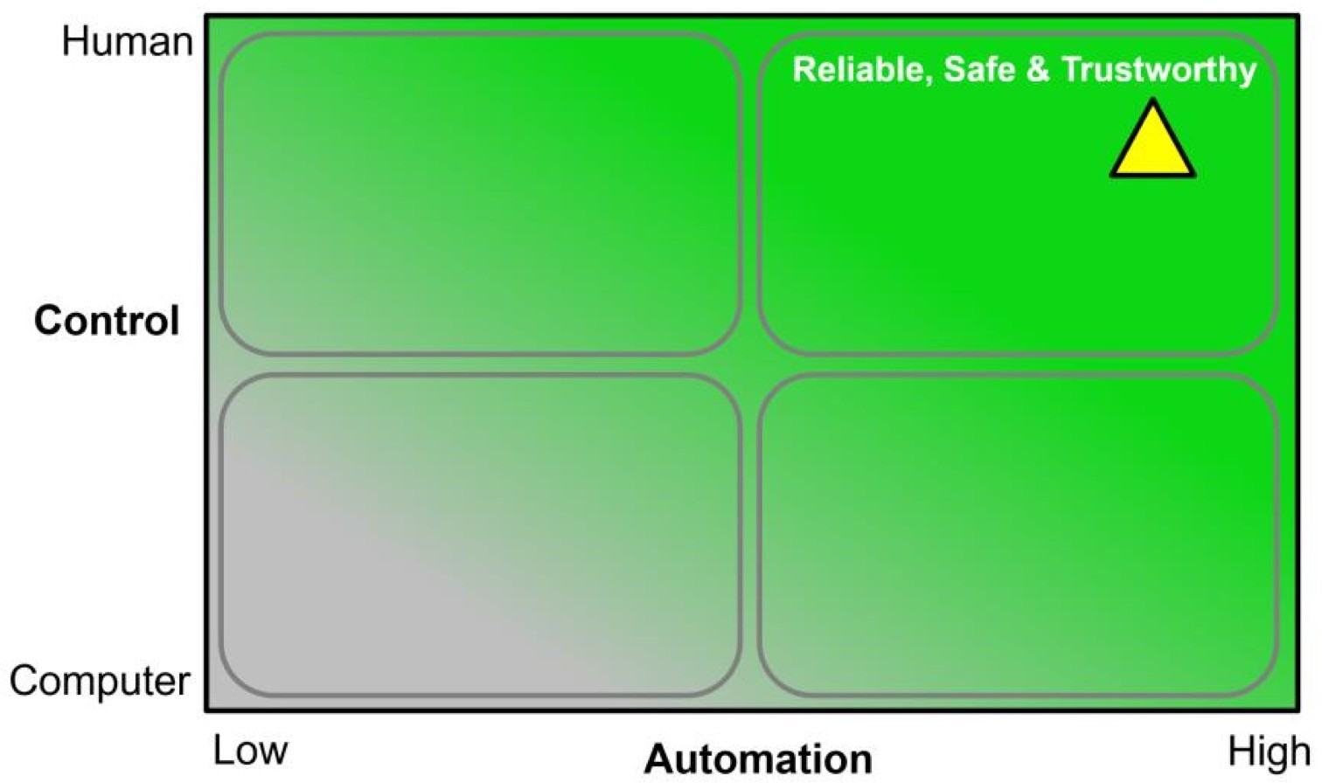
AI Goal: Application
Development of widely used products and services by applying AI methods, fulfilling some design goals
High-levels of human control and high levels of computer automation
HCI methods applied to identify needs and design goals
Ben Shneiderman, Design Lessons From AI’s Two Grand Goals: Human Emulation and Useful Applications. 2020. IEEE
Transactions on Technology and Society. https://doi.org/10.1109/TTS.2020.2992669

Slide 26
Interactive Human-Centered AI
“An Artificial Intelligence that enables interactive exploration and manipulation in real time and is designed with a clear purpose for human benefit while being transparent about who has control over data and algorithms.”
[A. Schmidt. Interactive Human Centered Artificial Intelligence: A Definition and Research Challenges. AVI 2020]
Interaction as a key for the collaboration between human and AI: the channel for the AI algorithm to support the users and for the users to control the algorithm
Observable Intelligence

Slide 27
Properties of Interactive Human-Centered AI
Individuals can interact in real time with the algorithms, models, and data
and can manipulate and control all relevant parameters
The impact of changes and manipulations made by the user can be observed in real time
Individuals can interactively explore why and how specific decisions are made and find out how changes in the parameters, data and models impact outcomes
In fast processes the speed can be reduced to allow interaction,
interventions and manipulations

Slide 28
Properties of Interactive Human-Centered AI
It states clearly how humans can benefit form the AI
It explains what risks the AI poses for individuals as well as on societal level
It is visible who has control on the AI, who has the power over data, models, algorithms
It is visible what data, knowledge base, and information is used to create and inform the AI

Slide 29
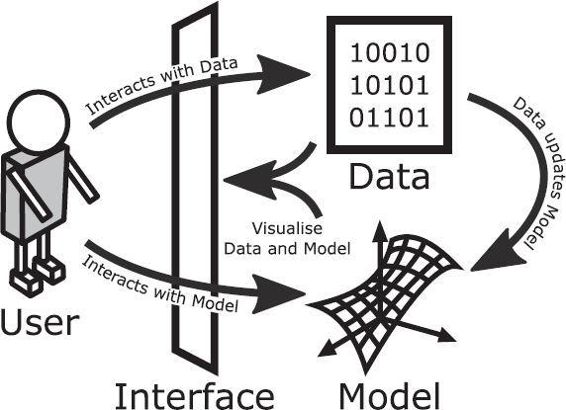
Understanding Systems
Not only opening code
not understandable for many people
little insights even for AI specialists
Design goals and functionality that the AI system is supposed to support
John J. Dudley and Per Ola Kristensson. 2018. A Review of User Interface Design for Interactive Machine Learning. ACM Trans. Interact. Intell. Syst. 8, 2, Article 8 (June 2018), https://doi.org/10.1145/3185517

Slide 30
Distinct Interface Elements
Output review
visualizing (a selection of) output samples
Feedback assignment
corrections and/or creation of new samples
Model inspection
Evaluation of the model quality
Task overview
Contextualizing tasks to help the assessment by naive users
Anything else?

Slide 31

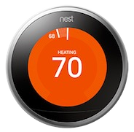
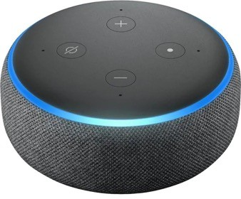
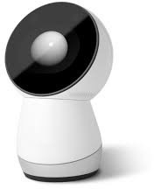
Human-Centered AI Framework
What if do we move to a 2D framework?
Ben Shneiderman, Human-Centered Artificial Intelligence: Reliable, Safe & Trustworthy. 2020. International Journal of Human-Computer Interaction. https://doi.org/10.1080/10447318.2020.1741118

Slide 32
Gmail spam filter
No input needed
User can override decisions already taken by the system

Slide 33

Google Nest thermostat
Initial set up
Automatic learning (very sensitive in the first two weeks, much less after)
Continuous adjustments in time
https://www.youtube.com/watch?v=20367DapHlc

Slide 34
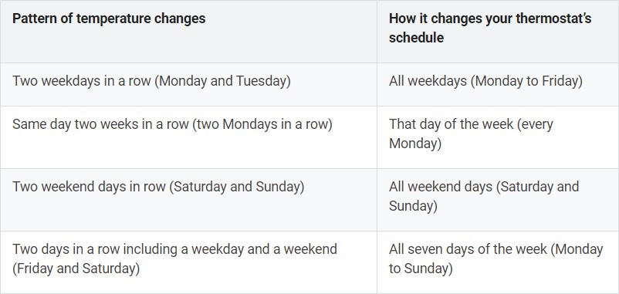
Google Nest thermostat
Automatic learning (very sensitive in the first two weeks, much less after)
Continuous adjustments in time

Slide 35

Amazon Alexa
Vocal commands in natural language
Vocal responses and actions
https://www.youtube.com/watch?v=Ymewnb3gJJQ

Slide 36

Amazon Alexa
Sorry, I’m having problems in understanding you right now…
https://www.youtube.com/watch?v=XQCHoKAq9xA

Slide 37

Google Home
https://www.youtube.com/watch?v=e2R0NSKtVA0

Slide 38

AI-based systems as smart tools

Slide 39
AI-based systems as smart tools
Digital technologies are Cognitive Artifacts: physical objects designed to display or operate about information for enhancing human cognition (Norman, 1991; Hutchins, 2002)
Cognitive Artifacts + Artificial Intelligence = smart tools
look like standard GUIs
aim to alleviate some tasks by acting autonomously
users are meant to be in control through the interface
might be confusing in terms of autonomy vs control because of probabilistic model

Slide 40

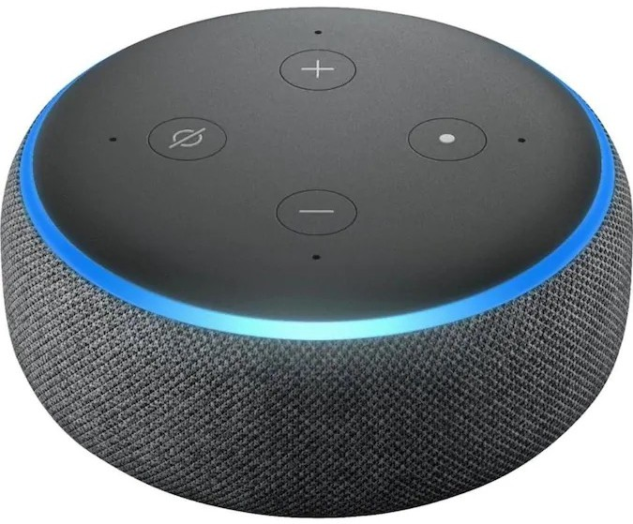
AI-based systems as artificial companions

Slide 41

AI-based systems as artificial companions
Interaction with intelligent systems based on the metaphor of human-human interaction
Human beings are coded to adopt an intentional stance
a tendency to anthropomorphize tools (e.g. Heider- Simmel illusion): yet, that does not imply that we actually believe that tools are intelligent (Reeves and Nass, 1996)
There is evidence that anthropomorphic features increases UX
anthropomorphic features increase trust in an automated car (Waytz, Heafner, and Epley 2014)
expression of emotions improves efficacy in collaborative decision making tasks (de Melo, Gratch, and Carnevale 2015)
Heider-Simmel Illusion (1944)

Slide 42

AI-based systems as artificial companions
Yet, in the long term, UX can worsen
the presence of an anthropomorphized helper reduces enjoyment in games (Kim et al., 2016)
over-reliance and over-trust can in the long term bring to security and safety issues (Chung et al., 2017)
Small aspects can induce larger and unwanted effects, e.g. people attribute negative stereotypes to female-presenting chatterbots more often than they do to male-presenting chatterbots (Brahnam & De Angeli, 2012)
Keep attention to the Uncanny Valley!

Slide 43
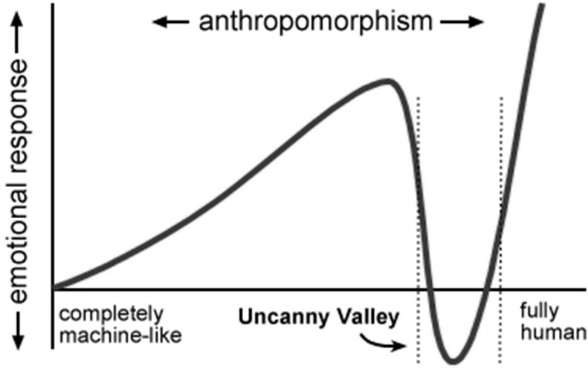
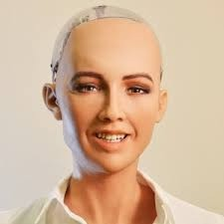
AI-based systems as artificial companions

Slide 44
Summing up
Smart Tools
Smarter but less predictable than objects
Opaque mental model
Principles of Interaction Design
New principles to manage AI
Artificial Companions
Almost but not like humans
Encourage social attribution
Uncanny valley
Different principles

Slide 45
AI: Risks, Benefits, and User Tolerance

Slide 46
What is Different in Interactive AI Systems?
AI-based systems are typically performed under
uncertainty
often producing false positives and false negatives
They may demonstrate unpredictable behaviors that can be disruptive, confusing, offensive, and even dangerous for users

Slide 47
Low-stake Examples
Relevance errors
Airbnb suggesting "fun local activities" when you are traveling for a funeral
Exercise app suggesting "time to get up and walk!" when you are seated on a long car trip
Multiple users, similar input
Use Spotify to play 1970s pop jams at a thematic party
Use Spotify to play your favorite study jams at home
Use Spotify to hate-listen to <insert here an artist you dislike> with your roommate
What music should Spotify recommend this account play?

Slide 48
What Are The Stakes For AI Failure?
User: low stakes
AI feature is annoying or interrupting
AI feature is often wrong
AI feature is useless
User: high stakes
AI causes active harm (e.g., recidivism prediction or hiring prediction)
AI reveals information someone wanted kept private
AI shows offensive content
Product/Service organization
Users stop using your app/service because of poor AI performance
Bad press or legal troubles
Bad reviews discouraging others from using the app/service

Slide 49
Traditional Guidelines and AI
AI-based systems can also violate established usability guidelines of traditional user interface design
for instance: consistency or error prevention
Many AI components are inherently inconsistent
they may respond differently to the same text input over time (e.g., autocompletion systems suggesting different words after language model updates)
or behave differently from one user to the next (e.g., search engines returning different results due to personalization)

Slide 50
What is an AI-based System?
Artificial intelligence (AI) refers to systems that display intelligent behaviour by analysing their environment and taking actions – with some degree of autonomy – to achieve specific goals.
AI for Europe, COM/2018/237 https://www.europeansources.info/record/communication-artificial-intelligence-for-europe/

Slide 51
What is an AI-based System?
Artificial intelligence (AI) refers to systems that display intelligent behaviour by analysing their environment and taking actions – with some degree of autonomy – to achieve specific goals.
Recognition
AI for Europe, COM/2018/237 https://www.europeansources.info/record/communication-artificial-intelligence-for-europe/

Slide 52
What is an AI-based System?
Artificial intelligence (AI) refers to systems that display intelligent behaviour by analysing their environment and taking actions – with some degree of autonomy – to achieve specific goals.
Recognition
Prediction
AI for Europe, COM/2018/237 https://www.europeansources.info/record/communication-artificial-intelligence-for-europe/

Slide 53
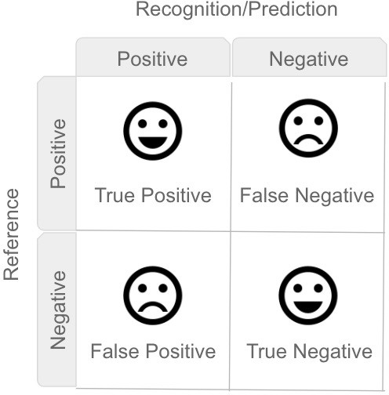
Optimizing for Precision vs. Optimizing for Recall

Slide 54
Optimizing for Precision vs. Optimizing for Recall
PRECISION = RECALL =

Slide 55
Optimizing for Precision vs. Optimizing for Recall
PRECISION = TP / (TP + FP)
RECALL = TP / (TP + FN)

Slide 56
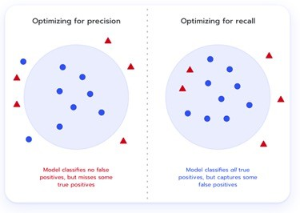
Optimizing for Precision vs. Optimizing for Recall
The worst thing is a false alarm
The worst thing is missing a positive

Slide 57
Should we optimizing for precision or recall?
3. Alexa
1. Gmail spam filter
4. Jibo
2. Google nest

Slide 58
How Can We Design Interactive AI Systems?
By shifting from measuring only algorithm performance to evaluating human performance and satisfaction, with human-centered and participatory approaches (for evaluation, too)
Deciding when "to AI" and when "not to AI"
Understanding when to automate (i.e., replace the user) and when to augment users' capabilities
Balancing the uncertainty of AI systems with proper expectations and feedback

Slide 59
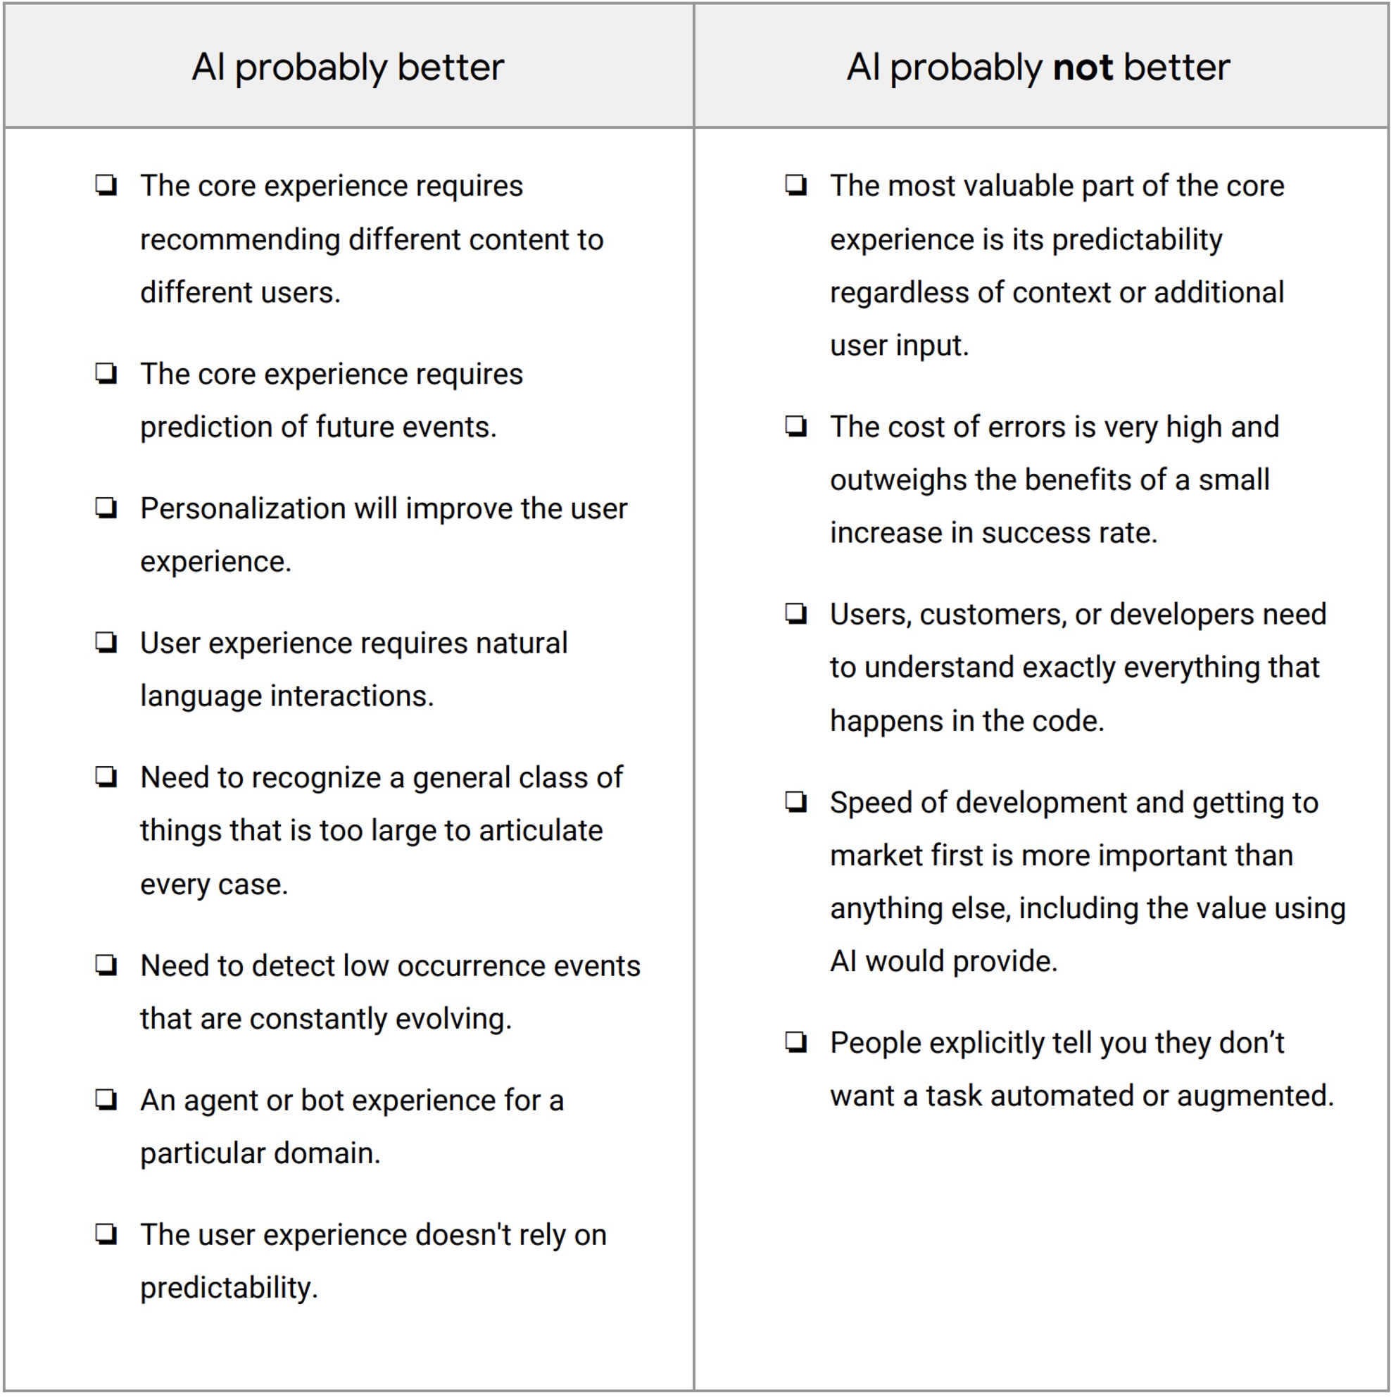
"To AI or not to AI?"
After identifying user needs and understanding how you can solve each of those needs
Ask yourselves: can AI solve the user need in a unique way? Why?
source: https://pair.withgoogle.com/worksheet/user-needs.pdf

Slide 60

source: https://developer.apple.com/design/human-interface-guidelines/machine-learning/overview/roles/
"Human-centered AI focuses on amplifying, augmenting, and enhancing human performance in ways that make systems reliable, safe, and trustworthy"
AI Features Meet Users
User tolerance to AI features depends on the role(s) of the feature
Critical or Complementary
if a system can still work without the feature that AI enables, AI is complementary
Proactive or Reactive
Proactive: it provides results without people requesting it to do so
Reactive: it provides results when people ask for them or when they take certain actions
Visible or Invisible
Dynamic or Static
how features evolve over time

Slide 61
User Tolerance: Critical or Complimentary
In general, the more critical an app feature is, the more people need accurate and reliable results
On the other hand, if a complementary feature delivers results that are not always of the highest quality, people may be more forgiving
Examples
Face ID -> critical or complementary?
Word suggestions (on smartphones keyboards) -> critical or complementary?
What happens if they fail?

Slide 62
User Tolerance: Proactive or Reactive
Proactive features can prompt new tasks and interactions by providing unexpected, sometimes serendipitous results
Reactive features typically help people as they perform their current task
Because people do not ask for the results that a proactive feature provides, they may have less tolerance for low-quality information
such features have more potential to be annoying

Slide 63

User Tolerance: Proactive or Reactive
Proactive features can be helpful
in small amounts
at the "right" moment
if they are easy to dismiss

Slide 64
User Tolerance: Visible or Invisible
People's impression of the reliability of results can differ depending on whether a feature is visible or invisible
With a visible feature, people form an opinion about the feature's reliability as they choose from among its results
It is harder for an invisible feature to communicate its reliability — and potentially receive feedback — because people may not be aware of the feature at all
Examples?

Slide 65
User Tolerance: Dynamic or Static
Dynamic features are those that improve as people interact with the system
e.g., face recognition for unlocking the phone
Static features optionally improve with a new system update
e.g., the quality of face recognitions in the photo library on a smartphone
Such improvements affect other parts of the user experience
dynamic features often incorporate some forms of calibration and feedback
(either implicit or explicit)
static features may not
Depending on the feature, such updates can modify the perceived reliability, safety, and/or trustworthiness of a system

Slide 66
User Tolerance To Give Feedback
Do not overuse feedback requests or users will get annoyed
People would not like to feel like the AI is so stupid that it needs their help
Save for high stakes failure, is possible

Slide 67
Choosing the People+AI Path
Guidelines for mitigating risks, increasing tolerance, and highlighting benefits

Slide 68
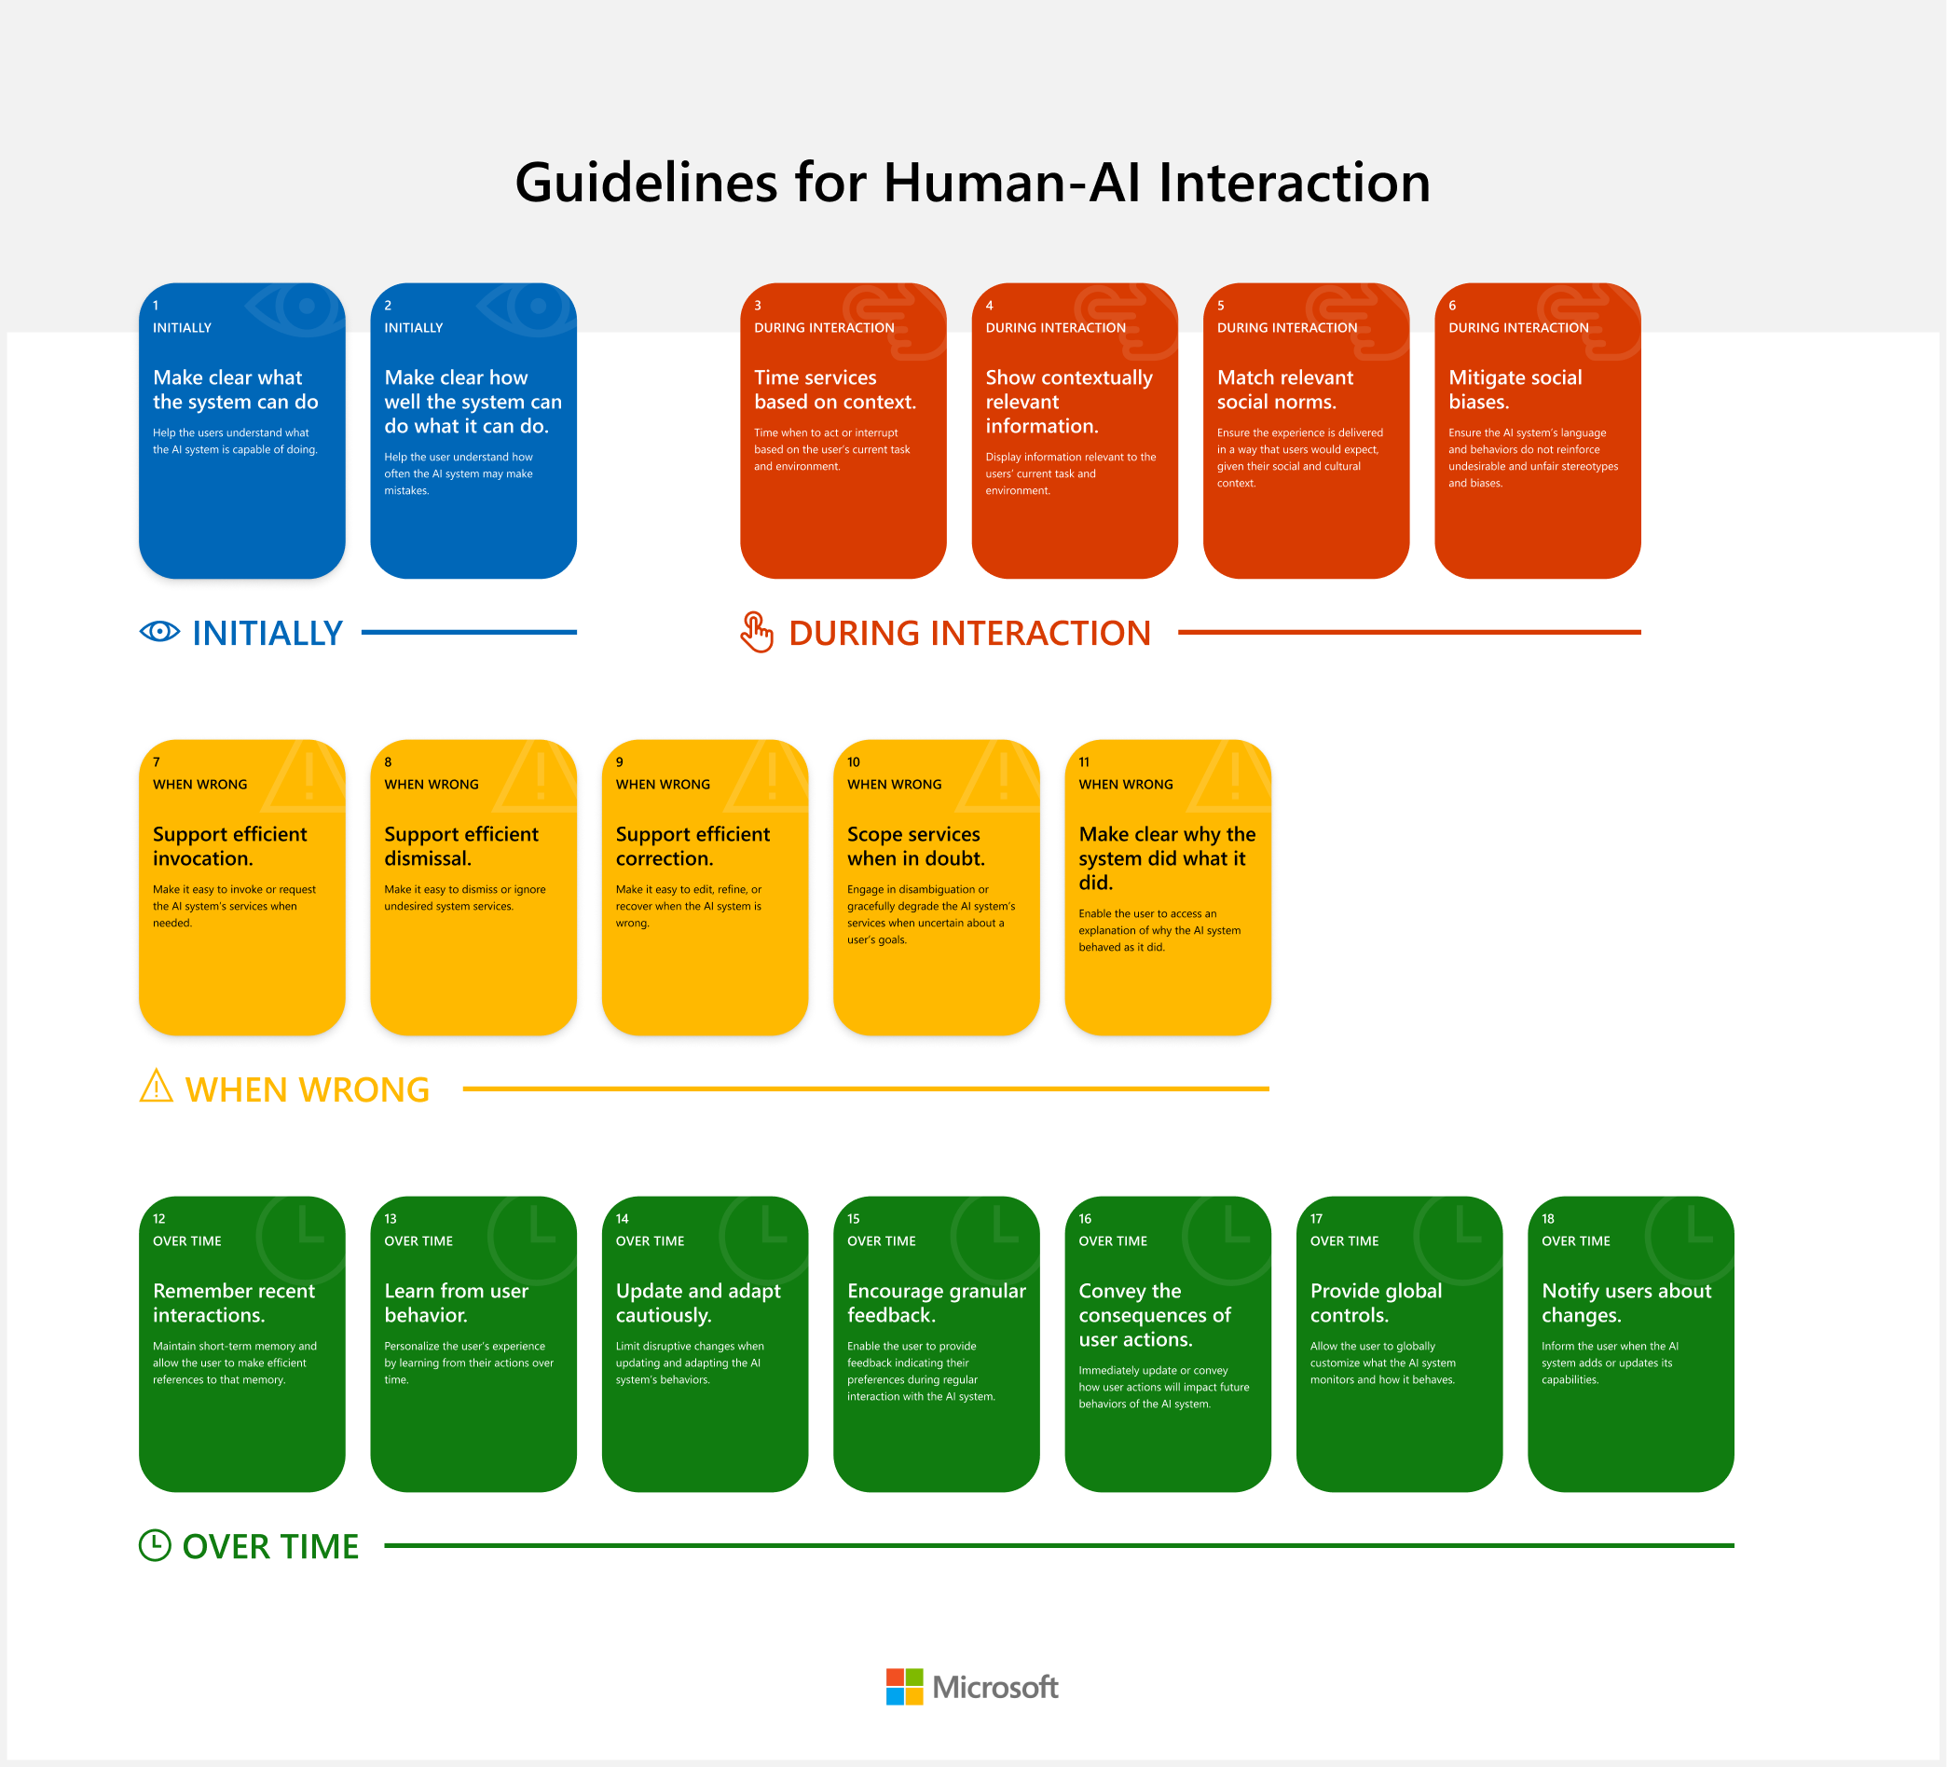
By Microsoft Research: https://www.microsoft.com/en-us/research/project/guidelines-for-human-ai-interaction/

Slide 69
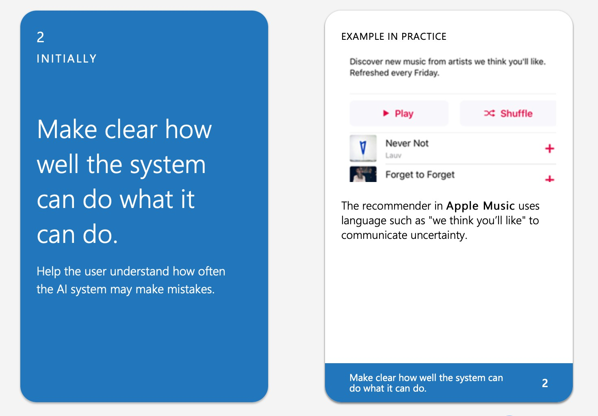

Slide 70
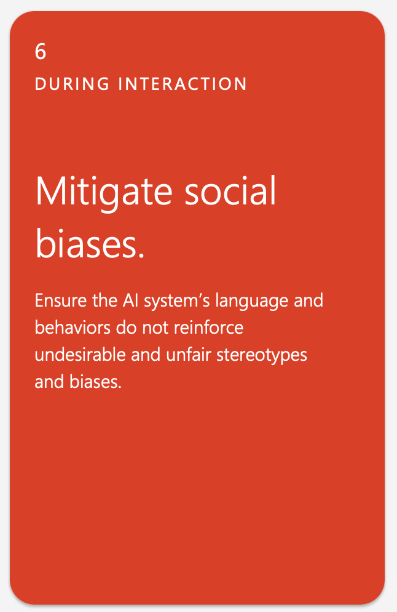
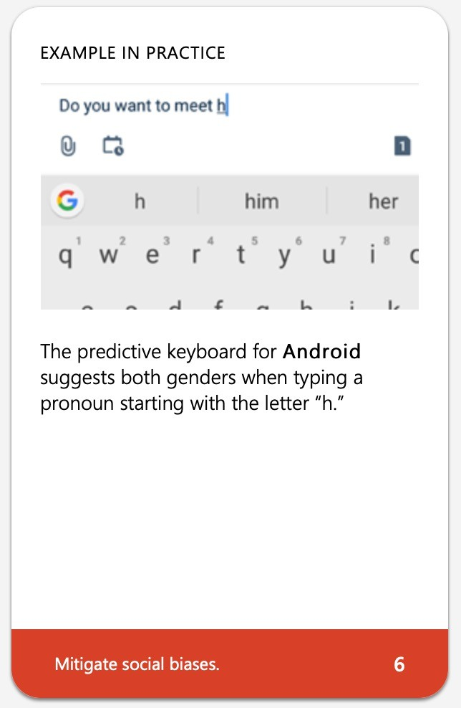

Slide 71
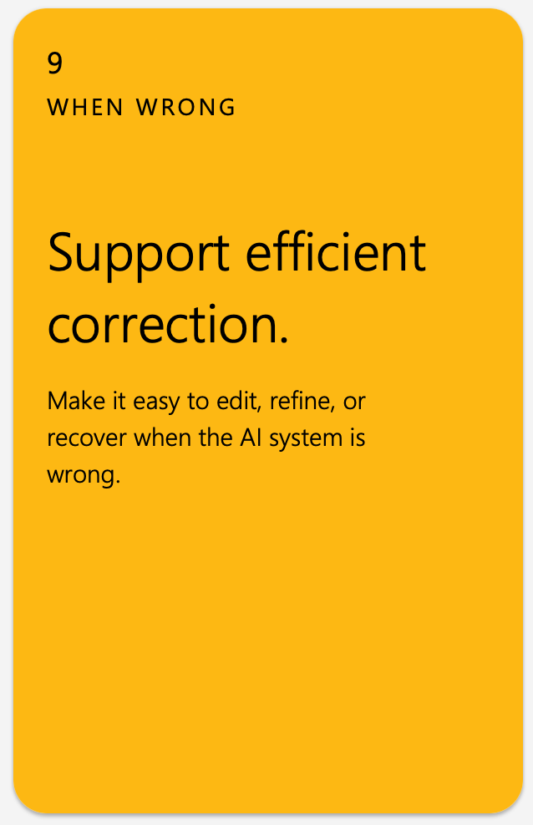
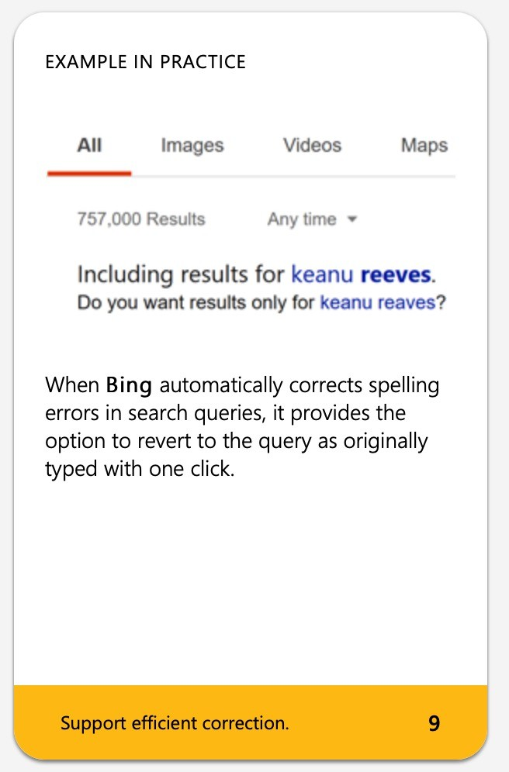

Slide 72
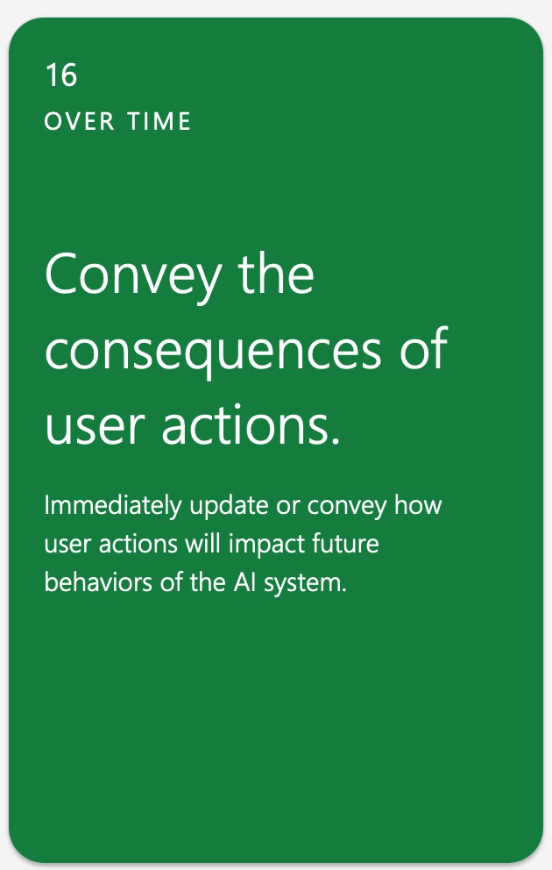
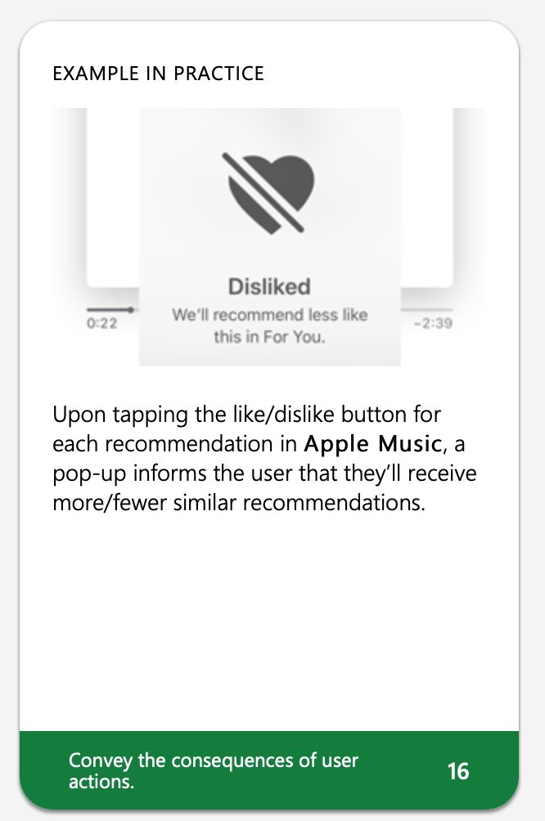

Slide 73
Other Guidelines
Google's People+AI Guidebook: https://pair.withgoogle.com/guidebook/
Apple's Human Interface Guidelines for Machine Learning: https://developer.apple.com/design/human-interface-guidelines/machine- learning/
Microsoft's Human-AI eXperience Toolkit: https://www.microsoft.com/en- us/haxtoolkit/

